Slide 1


<Name>
<Date>

Slide 2

Outline
Executive Summary
Introduction
Methodology
Results
Conclusion
Appendix

Slide 3
Executive Summary
Data was collected from the SpaceX API and Wikipedia page. A 'class' column labeled successful landings. Data exploration used SQL, visualizations, Folium maps, and dashboards. Features were selected, categorical variables were converted using one-hot encoding, and data was standardized. GridSearchCV identified optimal parameters for machine learning models, and accuracy scores were visualized.
Models were developed using , Logistic Regression, Support Vector Machine, Decision Tree Classifier, and K Nearest Neighbors. All achieved similar accuracy around 83.33%, with a tendency to over-predict successful landings.

Slide 4
Introduction
SpaceY, a competitor to SpaceX, uses SpaceX Falcon 9 rocket data to assess first-stage landing successes and determine launch costs to bid against SpaceX for rocket launches. SpaceX's Falcon 9 launch costs $62 million, compared to over $165 million for other companies.
Python and Jupyter notebooks are used for data collection and analysis throughout the project. These notebooks and the final PDF report are stored in my GitHub repository.
The report includes key areas: data collection methodology, data wrangling, exploratory data analysis (EDA), interactive data visualization, machine learning (ML) classification model development, and model evaluation.
The accuracy of different ML algorithms in predicting Falcon 9 first-stage landing outcomes is compared.

Slide 5

Section 1

Slide 6
Methodology
Executive Summary
Data collection methodology:
The data used in this project were collected from the SpaceX REST API and the Wikipedia launch table.
Performed data wrangling
The data wrangling process involved cleaning, preparing the data for visualization, and extracting information for use in machine learning predictive models such as logistic regression, support vector machine (SVM), decision tree, and K-nearest neighbors (KNN).
Performed exploratory data analysis (EDA) using visualization and SQL
Performed interactive visual analytics using Folium and Plotly Dash
Performed predictive analysis using classification models

Slide 7
Data Collection
The data collection process involved a combination of API requests from the SpaceX public API and web scraping data from a table in SpaceX’s Wikipedia entry.
The API provided detailed data columns such as FlightNumber, Date, BoosterVersion, PayloadMass, Orbit, LaunchSite, Outcome, and more.
The web scraping process extracted columns like Flight No., Launch site, Payload, PayloadMass, Orbit, Customer, Launch outcome, Booster version, Booster landing, Date, and Time.

Slide 8
Data Collection – SpaceX API
1. Initialize API Connection:
Set up the connection to the SpaceX API to prepare for data requests.
2. Send API Request:
Formulate and send a request to the SpaceX API to retrieve the desired data.
3. Receive API Response:
Wait for the API to respond and receive the data.
4. Check Response Status:
Verify that the response status is OK. If not, log the error and resend the request.
5. Parse and Store Data:
Extract and parse the received data, then store it in a suitable format (e.g., DataFrame, database).
6. Validate Data:
Ensure the collected data is complete and accurate. If not, log the error and resend the request if necessary.
Link to Github

Slide 9
Data Collection - Scraping
2. Requesting the Wikipedia Page:
GET request is made to a static URL of the Wikipedia page to retrieve launch records.
3. Creating BeautifulSoup Object
4. Extracting, Converting and storing data into dataframe
1. Library Imports and Setup:
Libraries (requests, BeautifulSoup, pandas) are imported.
Link to Github - Web scraping

Slide 10
Data Wrangling
Various data wrangling steps are carried out, including handling missing values, converting data types, and creating new columns from existing data.
Carried out visualization of launch sites, payload masses, and orbits to understand their distribution and impact on the landing outcome.
Specific columns like FlightNumber, PayloadMass, Orbit, LaunchSite, and LandingOutcome are extracted and cleaned for use in machine learning models.
The cleaned and processed DataFrame is saved for further analysis
Link to Github - Data Wrangling

Slide 11
EDA with Data Visualization
Data visualization using Matplotlib and Seaborn were conducted. The trends in Flight Number, Payload Mass, Launch Site, Orbit, Class are explored
Plots Used:
Flight Number vs. Payload Mass
Flight Number vs. Launch Site
Payload Mass vs. Launch Site
Orbit vs. Success Rate
Flight Number vs. Orbit
Payload vs. Orbit
Scatter plots, line charts, and bar plots were utilized to compare relationships between variables to determine if any relationships exist, which could then be used to train the machine learning model.
Data Visualisation - Github link

Slide 12
EDA with SQL
Established a connection to a SQL database, where the SpaceX dataset is loaded and stored in a table
Various SQL queries are executed to explore and analyze the dataset. Tasks include counting launches by site, calculating total payload mass for specific customers, and finding average payload mass for different booster versions.
The analysis involved counting the total number of successful and failed mission outcomes and identifying boosters that have carried the maximum payload mass.
Github Link to Exploratory Data Analysis

Slide 13
Build an Interactive Map with Folium
1. Marked all Launch Sites:
Created a map using Folium and add markers with circles, popup labels, and text labels to each launch site using their longitude and latitude coordinates. This will display the geographical locations relative to the equator.
2. Indicated Success/Failure of Launches:
Used colored markers on the map to indicate successful or failed launches for each site.
3. Calculated Distances:
Computed the distance between each launch site and its proximities.
Github link
https://github.com/Sruthimohan05/IBM_data_science_capstonee/blob/main/Visualisation%20using%20Folium.ipynb

Slide 14
Build a Dashboard with Plotly Dash
The dashboard includes a pie chart and a scatter plot:
The pie chart can display the distribution of successful landings across all launch sites or show the success rates for individual launch sites.
The scatter plot accepts two inputs: selection of all sites or an individual site, and a payload mass range adjustable with a slider between 0 and 10,000 kg.
The pie chart visualizes the success rates of launch sites.
The scatter plot illustrates how success varies by launch sites, payload mass, and booster version category.
Github link
https://github.com/Sruthimohan05/IBM_data_science_capstonee/blob/main/Dash_Plotly.py

Slide 15

Section 2

Slide 16
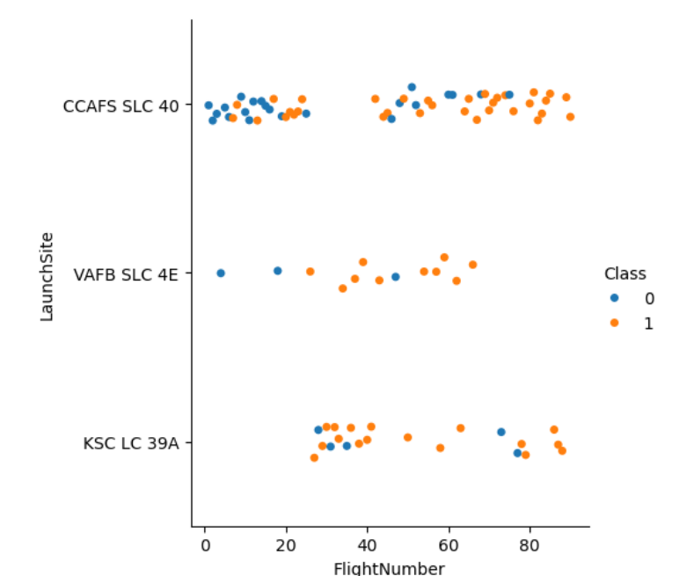
Flight Number vs. Launch Site
Scatter plot of Flight Number vs. Launch Site
More flights from launch site CCAFS SLC 40
Newer flights have higher success rate than older ones

Slide 17
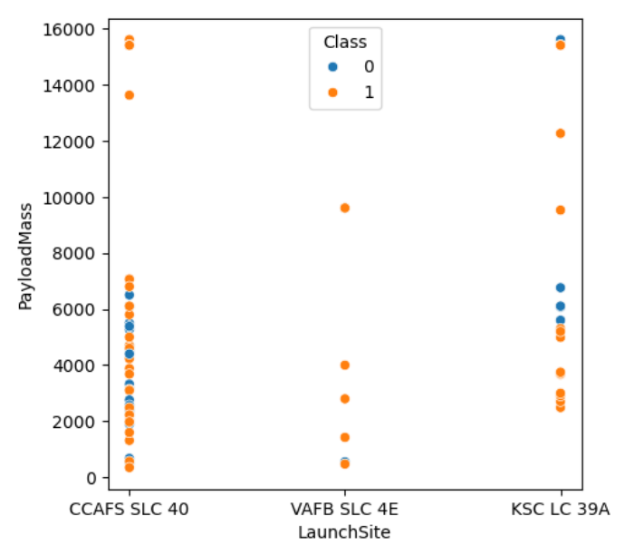
Payload vs. Launch Site
Scatter plot of Payload vs. Launch Site
VAFB SLC 4E launch site deploys payloads with mass less than 10000 kg and all launches were successful

Slide 18
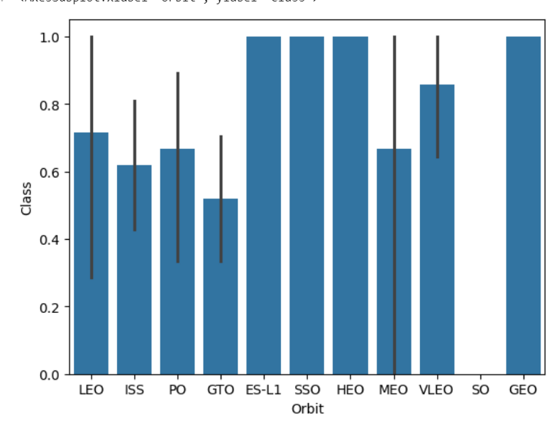
Success Rate vs. Orbit Type
Bar chart for the success rate of each orbit type
Four orbits have 100% success rate
All orbits have success rate above 40% except SO

Slide 19
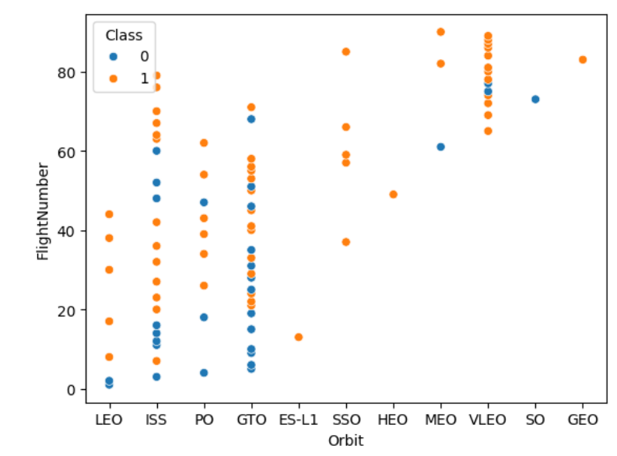
Flight Number vs. Orbit Type
A scatter point of Flight number vs. Orbit type is shown
The majority of the flights were launches to the ISS and GTO orbits

Slide 20
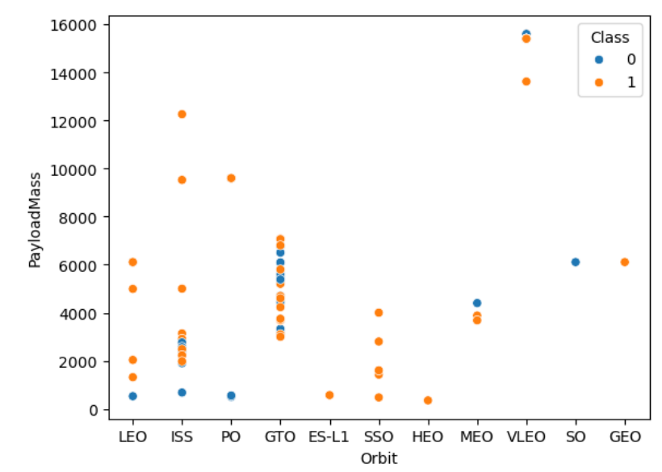
Payload vs. Orbit Type
A scatter point of payload vs. orbit type
Payload mass above 800 kg is placed only in ISS, PO and VLEO

Slide 21
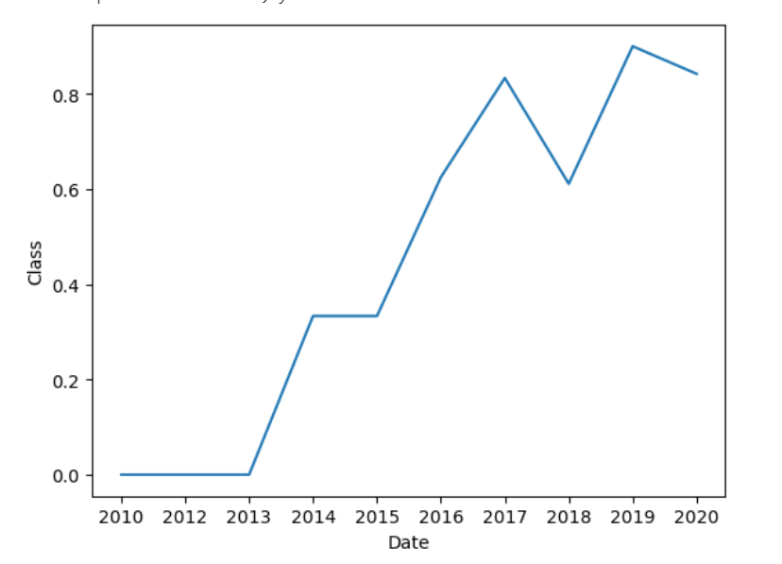
Launch Success Yearly Trend
Line chart of yearly average success rate
The success rate increases with time. Nearly 90% success rate in 2020

Slide 22
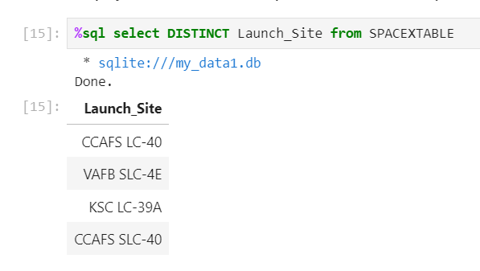
All Launch Site Names
Names of unique launch sites
There are four distinct launch sites

Slide 23
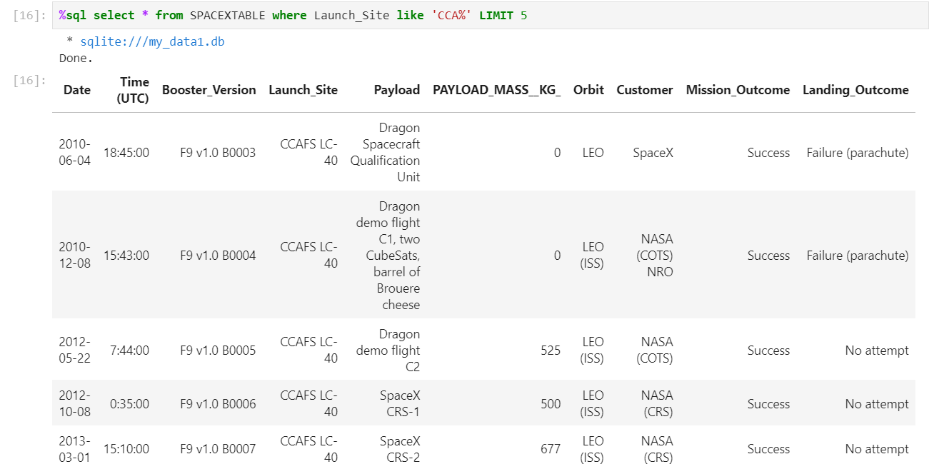
Launch Site Names Begin with 'CCA'
Find 5 records where launch sites begin with `CCA`

Slide 24
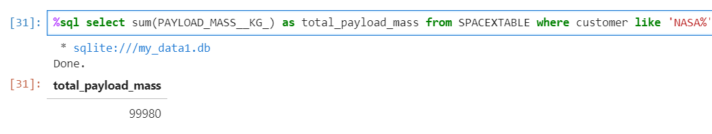
Total Payload Mass
Calculate the total payload carried by boosters from NASA
The total payload mass carried is 99980 kg

Slide 25
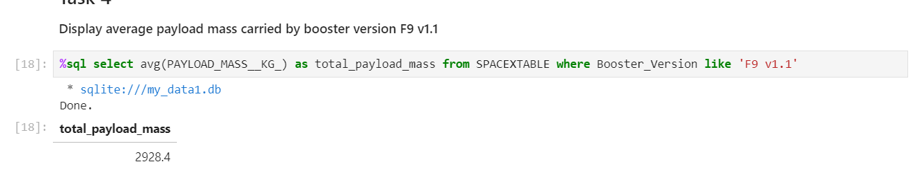
Average Payload Mass by F9 v1.1
Calculate the average payload mass carried by booster version F9 v1.1

Slide 26
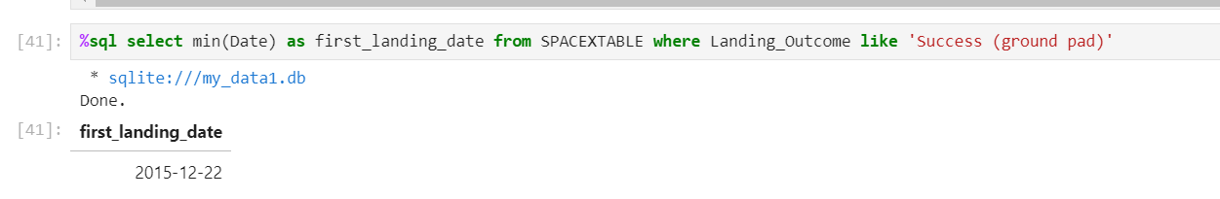
First Successful Ground Landing Date
Find the dates of the first successful landing outcome on ground pad

Slide 27
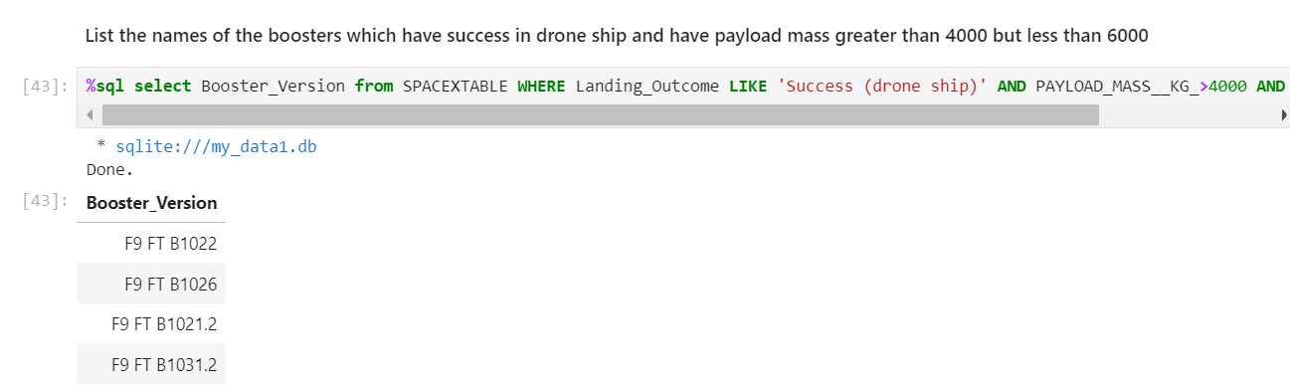
Successful Drone Ship Landing with Payload between 4000 and 6000
List the names of boosters which have successfully landed on drone ship and had payload mass greater than 4000 but less than 6000

Slide 28
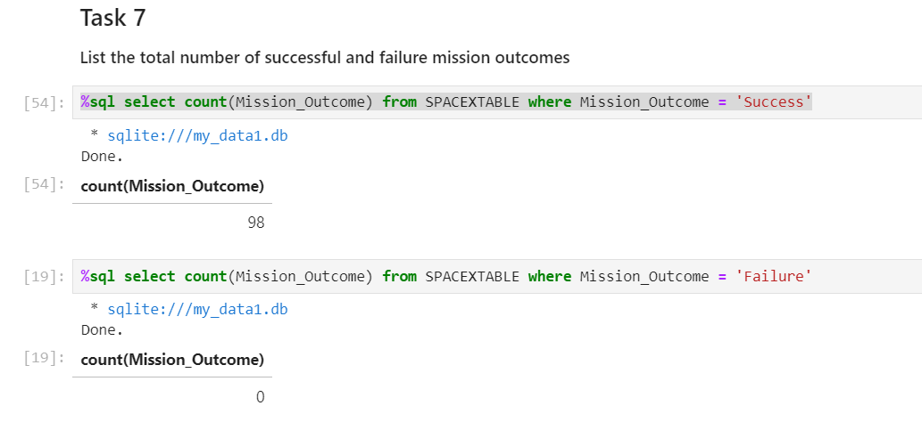
Total Number of Successful and Failure Mission Outcomes
Calculate the total number of successful and failure mission outcomes
98 successful missions and 1 failure missions

Slide 29
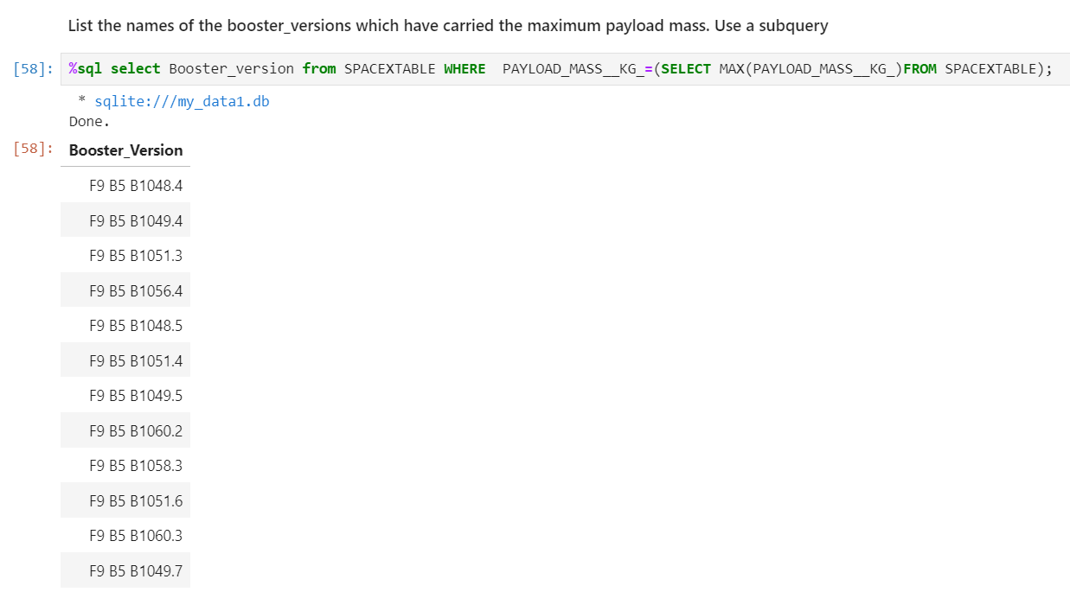
Boosters Carried Maximum Payload
List the names of the booster which have carried the maximum payload mass

Slide 30
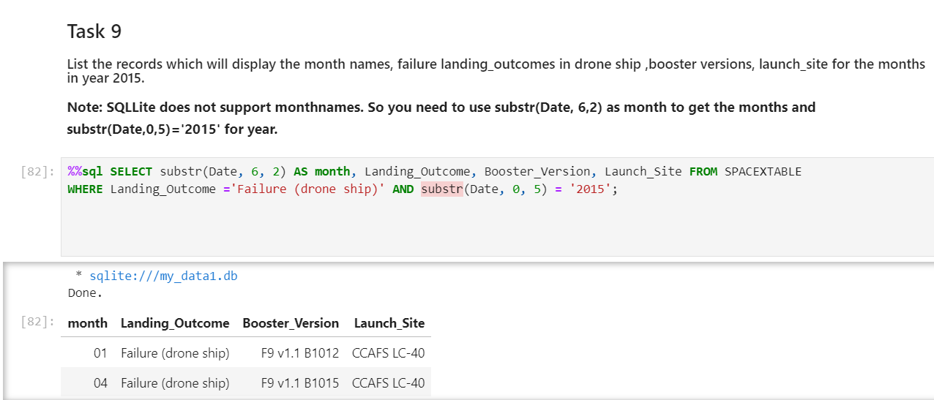
2015 Launch Records
List the failed landing_outcomes in drone ship, their booster versions, and launch site names for in year 2015

Slide 31
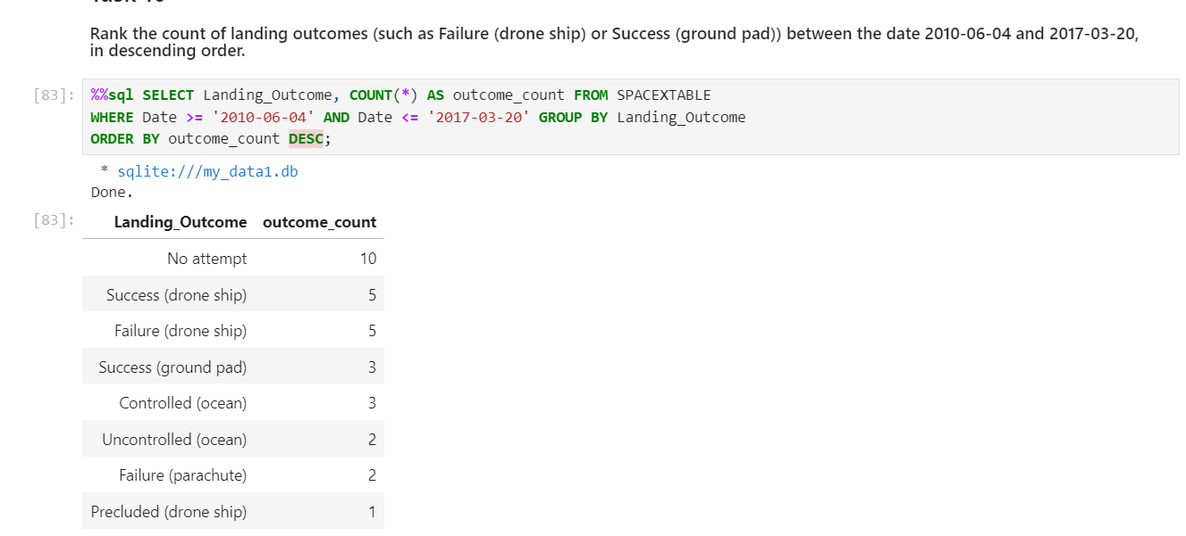
Rank Landing Outcomes Between 2010-06-04 and 2017-03-20
Rank the count of landing outcomes (such as Failure (drone ship) or Success (ground pad)) between the date 2010-06-04 and 2017-03-20, in descending order

Slide 32

Section 3

Slide 33

Launch sites
Replace <Folium map screenshot 1> title with an appropriate title
Explore the generated folium map and make a proper screenshot to include all launch sites’ location markers on a global map
Explain the important elements and findings on the screenshot
All launch sites are close to the ocean

Slide 34

Color coded markers
Successful launches are marked by green and unsuccessful ones are marked by red

Slide 35



Safe distance from railway lines
The launch sites are at safe distance from railway lines, city and highway.
They are close to the coast

Slide 36

Section 4

Slide 37
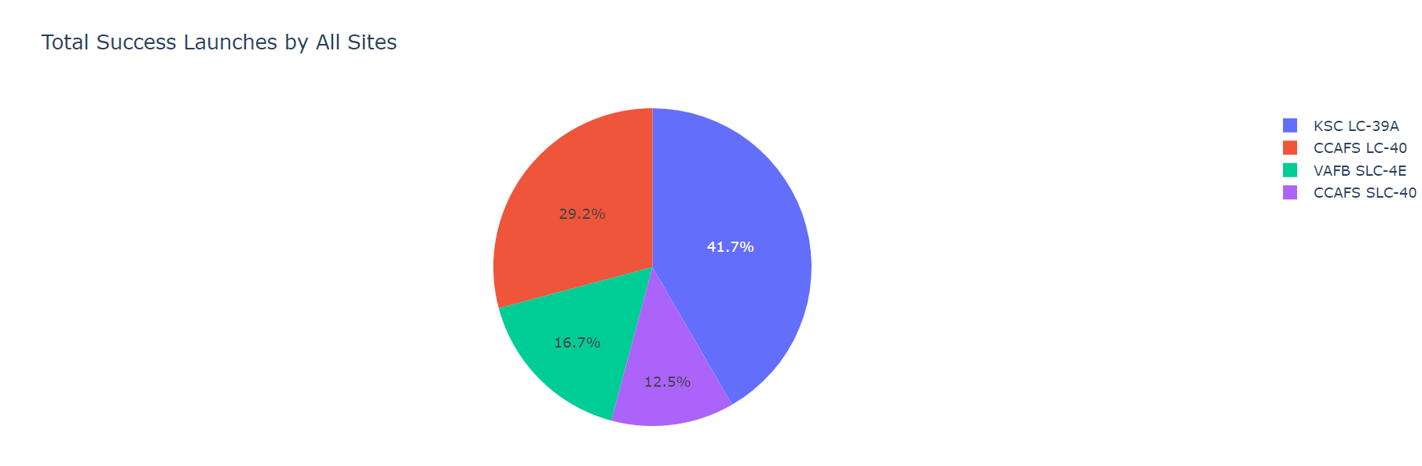
Total success launch by all sites
CCAFS LC -40 has maximum success

Slide 38
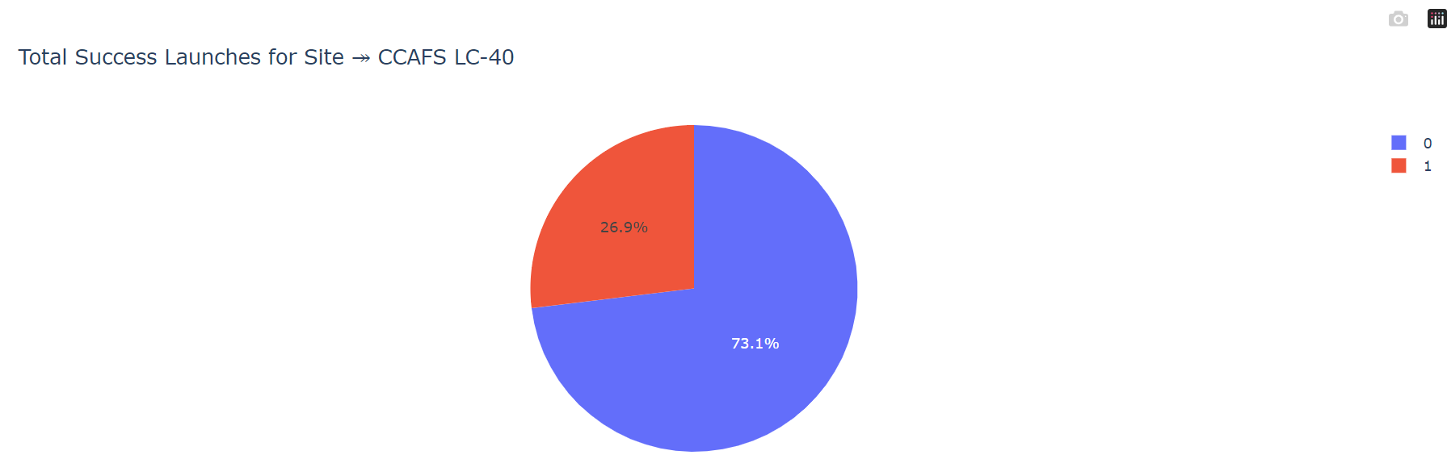
Highest Launch success ratio
It is for the site CCAFS - 40

Slide 39
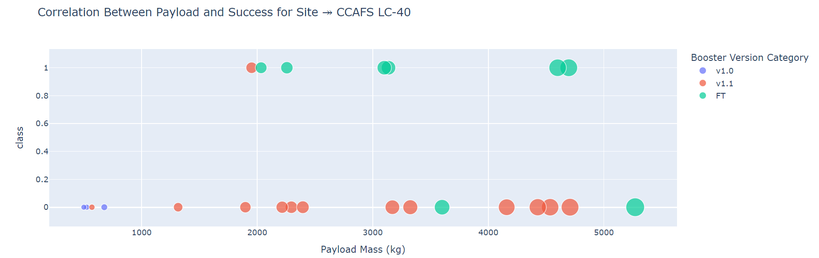
Payload Vs launch Outcome

Slide 40

Section 5

Slide 41

Classification Accuracy
Figure shows the built model accuracy for all built classification models, in a bar chart
All models have same classification accuracy

Slide 42

Confusion Matrix
TP
FP
FN
TN
15 outcomes are correctly predicted

Slide 43
Conclusions
Machine learning model is developed for SpaceY to compete with SpaceX by predicting the successful landing of Stage 1, potentially saving around $100 million USD.
Data was gathered from the SpaceX public API and by web scraping the SpaceX Wikipedia page, then labeled and stored in a DB2 SQL database.
A dashboard was created for visualization purposes, helping to present the data effectively.
We developed a machine learning model that achieved an accuracy rate of 83%.
This model allows SpaceY's Allon Mask to predict with high accuracy whether a launch will successfully land Stage 1, guiding decisions on whether to proceed with the launch. Collecting more data could further improve the model's accuracy.

Slide 44
Appendix
Github repository containing all codes;
https://github.com/Sruthimohan05/IBM_data_science_capstonee/tree/main

Slide 45


